Slide 1


Research Reviews on
High-redshift Quasars
Department of Astronomy, Beijing Normal University
吕澈秋（Cheqiu Lyu）
Shanghai Astronomical Observatory
2018.8.29

Slide 2
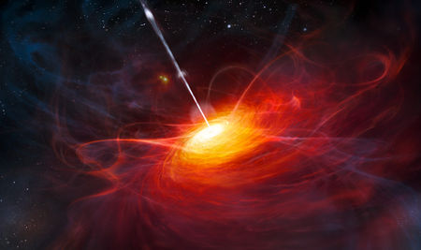
CONTENTS
01
Introduction of high-z quasars
02
Search and confirmations
03
Radio quasars
04
Super massive black hole
05
Summary and Future

Slide 3
NO.1
Introduction of high-z quasars

Slide 4
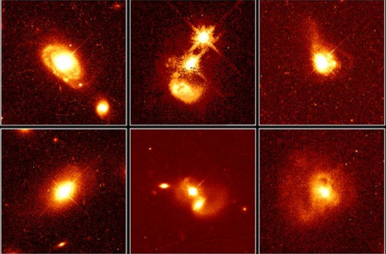
NO.1
Introduction
Quasar (also known as a QSO or quasi-stellar object)
is an extremely luminous active galactic nucleus (AGN).
In quasars and other types of AGN, the black hole is surrounded by a gaseous accretion disk. As gas in the accretion disk falls toward the black hole, energy is released in the form of electromagnetic radiation.
Notes:
This radiation can be observed across the electromagnetic spectrum at radio, infrared, visible, ultraviolet, and X-ray, and gamma wavelengths. The power radiated by quasars is enormous: the most powerful quasars have luminosities exceeding 10⁴¹ watts, thousands of times greater than an ordinary large galaxy such as the Milky Way.

Slide 5
NO.1
Introduction
"quasar" originated as quasi-stellar [star-like] radio source
1950s first identified as unknown sources of radio-wave emission,
photographic images at visible wavelengths ->faint star-like points of light.
High-resolution images(HST):
Quasars occur in the center of galaxies
(Some in interacting or merging galaxies)
>200,000 quasars now
Notes:
The term "quasar" originated as a contraction of quasi-stellar [star-like] radio source, because quasars were first identified during the 1950s as sources of radio-wave emission of unknown physical origin, and when identified in photographic images at visible wavelengths they resembled faint star-like points of light. “类星体”一词起源于准恒星[类恒星]射电源的收缩，因为类星体最初是在20世纪50年代被确定为物理来源不明的无线电波发射源，当它们在可见波长的摄影图像中被识别时，它们类似于微弱的类恒星光点。High-resolution images of quasars, particularly from the Hubble Space Telescope, have demonstrated that quasars occur in the centers of galaxies, and that some quasar host galaxies are strongly interacting or merging galaxies.^{[3]} As with other categories of AGN, the observed properties of a quasar depend on many factors including the mass of the black hole, the rate of gas accretion, the orientation of the accretion disk relative to the observer, the presence or absence of a jet, and the degree of obscuration by gas and dust within the host galaxy

Slide 6
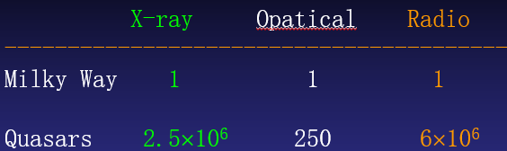
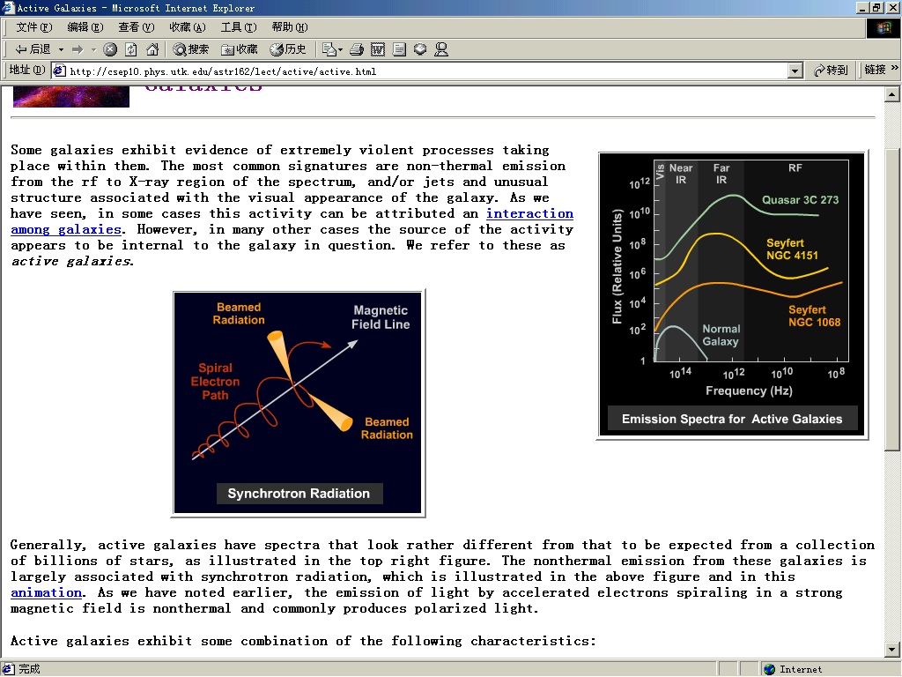
NO.1
Introduction
Observation characteristics
1. High luminosity
2. Non-thermal continuous，
high polarization radiation
Synchrotron radiation
Notes:
但是类星体产生的能量是在黑洞外部、在黑洞轨道和向内落下时由于引力应力和最接近黑洞的材料内的巨大摩擦而产生的。类星体的亮度是由中心超大质量黑洞的积聚盘产生的，它可以把物体质量的6%到32%转化为能量，[33]相比之下，在太阳系中占主导能量产生的p-p链核聚变过程只有0.7%
同步加速辐射 (Synchrotron Radiation)相对论性电子在磁场中作圆轨道或螺旋轨道运动时产生的辐射
连续辐射, 幂率谱, 显著的偏振性

Slide 7
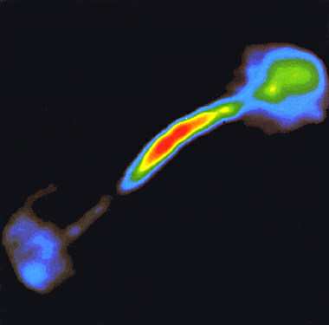
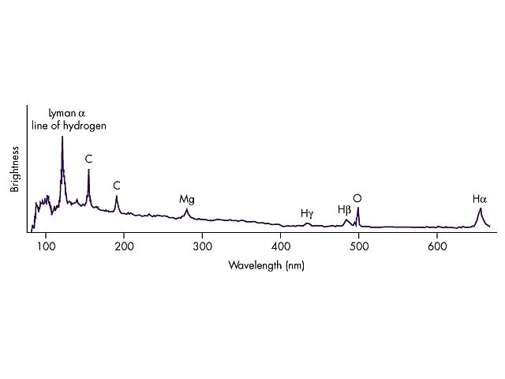
NO.1
Introduction
Observation characteristics
3. Special shape
(Bright nucleus, jet flow, irregular shape)
Binary BH?
numerical simulation of Jet flow
4. Strong emission lines
Notes:
Quasars usually have jet flows, and radio sources usually have two petal structures.

Slide 8
NO.1
Introduction
High-Redshift
First quasar 3C273, z=0.158
Most distant z > 7, from early universe(~Gyr)
Early form of normal galaxies?
Later, they begin to stabilize, SMBH activity became relaxed, galaxies began to evolve structures, the so-called "quasars" will naturally disappear.
High-z :Probe of early universe and EoR
Notes:
绝大多数类星体都有非常大的红移值（用Z表示）。类星体3C273（QSO1227+02）的Z=0.158，远远超过了一般恒星的红移值。有不少类星体的红移值超过了1，有的甚至达到4以上，至今发现的最远的类星体为ULAS J1120+0641，其红移达到7.1。根据哈勃定律，它们的距离远在几亿到上百亿光年之外。
对AGN的模型好像大致是多数AGN是星系演化的早期形式，等到后期星系整体开始趋于稳定，SMBH的活动变得缓和，星系开始演化出结构之后，所谓“类星体”，也就自然消亡了。

Slide 9
NO.2
Search and discovery

Slide 10
NO.2
Search and confirmations
Spectrum characteristics
1.wide permitted emission lines, such as Ly- alpha, CIV, CIII, MgII, width~ 10³-10⁴km/s
2.narrow forbidden lines and semi-forbidden lines, width~500km/s
3. continuous，power law spectrum (extend to infrared and radio)
4.long-wave side of Ly- alpha, the narrow metal absorption line
short-wave side of Ly-a, absorption lines forest
5. Ly-a series limits at a static wavelength of 912 A, sudden jump in the quasar spectrum

Slide 11
NO.2
Search and confirmations
Significance of more and more high-z quasars
Built a color-selected flux-limited samples
-> luminosity function of quasars
-> evolution of quasars’ spatial density
->early evolution of quasars and other AGN, galaxies
Notes:
selection effect is avoided
Elliptical galaxies, spiral galaxies, radio loud q, radio quiet quasars

Slide 12
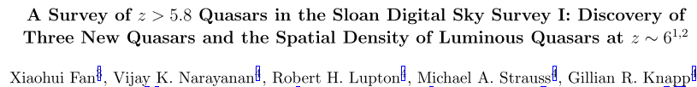
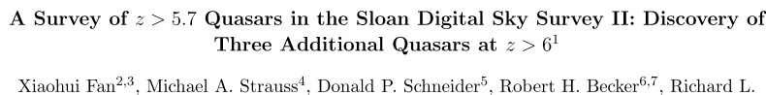
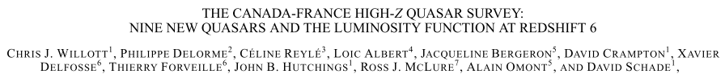
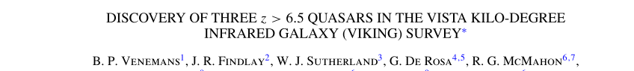
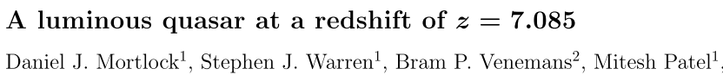
NO.2
Search and confirmations
Most principal characteristics: Strong and broad Ly a +NV emission line, very strong Ly a absorption forest
Most are from SDSS(opitcal)

Slide 13
JHK
NO.2
Search and confirmations
Main method: multicolor photometry, i-dropout survey
u, g, r, i, z band (z~>5.8, whose Lyman a absorption line lies in i-band )
SDSS database-> I-dropout source->Visual inspection->cross-matching with other survey data(e.g. 2MASS)->JHK photometry->
z-j index(separate quasar and cold dwarf candidates )
Notes:
问题：在 z= 3.6, 4.6 ，5.5Lyα发射线会红移到 SDSS g, r ，i波段。超过 5.5, 高红移只可侧一种颜色了

Slide 14
NO.2
Search and confirmations
Difficulty of detection
1. scarce and dim in optical waveband
2. need for detailed spectroscopic data and a large amount of observation time
3. significantly different in spectral index, brightness variations and energy distributions
4. due to the redshift relation, the wavelength range depends on the redshift (need infrared and radio)

Slide 15
NO.2
Search and confirmations
High-z quasars searching and confirmations in RADIO band:
cover large areas of the sky.
2. with high position accuracy, the quasar selection is not affected by its own spectral characteristics.
3. Radio unaffected by dust, study the influence of dust on optically selected quasar samples
4.Study the evolution of elliptical galaxies(RLQ), spiral galaxies(RQQ)
Limition: About 90% of quasars are radio-quiet
Can't get red-shift information based solely on radio properties,
Notes:
selection effect is avoided
Elliptical galaxies, spiral galaxies, radio loud q, radio quiet quasars

Slide 16
NO.3
Radio quasars

Slide 17
NO.3
Radio quasars
Radio quasars can be divided to radio loud quasars(RLQ) and radio quiet quasars(RQQ) by intensity of radio radiation R, distribution is bimodal.
R = f (5GHz) / f (4400A) = 10 or 5GHz radio luminosity pair equals 10 ²⁴WHz ⁻ ¹Sr ⁻ ¹
Some differences?
Astrophysical or selection effect ?
the nature is not clear

Slide 18
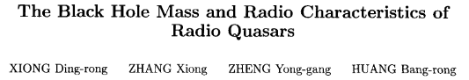
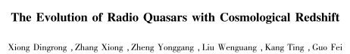
NO.3
Radio quasars
Statistical results of large samples are needed
117quasars(20RQQ&97RLQ)
142 quasars(28RQQ&114 RLQ)
Redshift, bolometric luminosity, Hβ emission line width， 5100A monochromatic luminosity, Radio noisiness, 5 GHz radio luminosity…z from 0.1~2 (not so high)

Slide 19
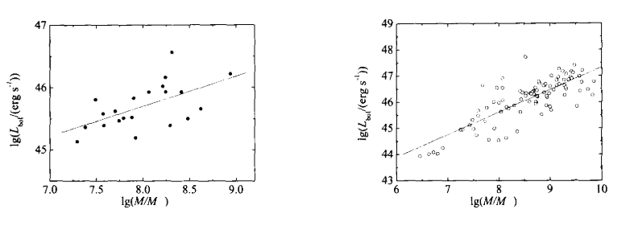
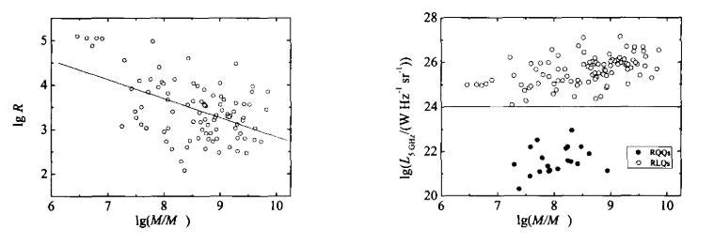
NO.3
Radio quasars
Logistic nonlinear regression
Notes:
RQQ的热光度与黑洞质量弱相关，RLQ的热光度与黑洞质量强相关
射电噪度与中心黑洞质量有很强的反相关性
There is a strong inverse correlation between
R can be used for differentiate RQQ and RLQ

Slide 20
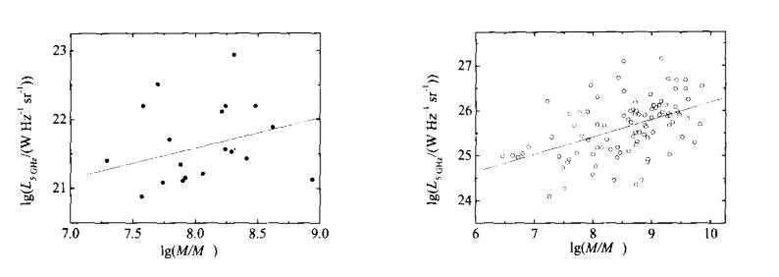
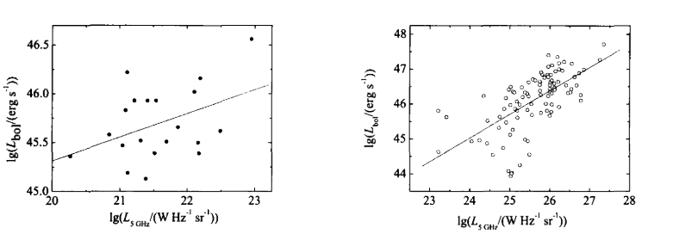
NO.3
Radio quasars
The difference may be due to
intrinsic physical properties
Notes:
RQQ黑洞质量和5GHz光度弱相关，RLQ黑洞质量和5GHz光度强相关
黑洞质量和热光度the difference may be due to intrinsic physical properties

Slide 21
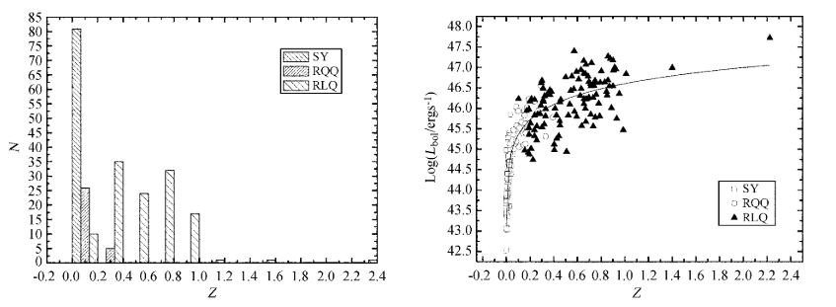
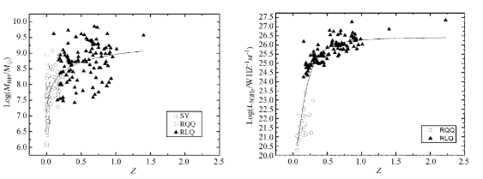
NO.3
Radio quasars
Redshift relationship
RLQ->RQQ->Seyfert?
Notes:
红移分布从0到1以上，Seyfert 星系的红移分布在0 ～ 0． 07 的范围; 射电宁静类星体的红移分布在0． 07 ～ 0． 3 的范围; 射电噪类星体的红移分布在0． 3 ～ 2． 4 的范围
热光度和红移慢慢变 小，射电噪类星体演化为射电宁静类星体，当演化进行到一定阶段，射电类星体过渡到 Seyfert 星系
可能演化：射电噪类星体→射电宁静类星体→Seyfert 星系的演化
:活动星系核的一个亚型，是一类中心有明亮恒星状天体的旋涡星系1型：同时包括宽窄两类辐射频带。
2型：只包括窄辐射频带。

Slide 22
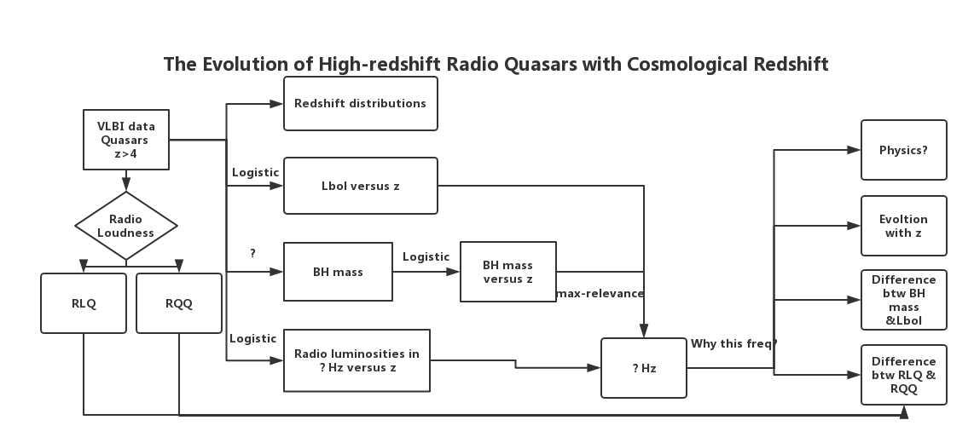
NO.3
Radio quasars
MY IDEAS
Notes:
Find out the frequency at which the flux has the Maximum correlation

Slide 23
NO.4
SMBH

Slide 24
NO.4
SMBH
High resolution observations
-> size of galactic core;
Gas dynamics around core
->mass of galactic core
-> mass/spatial size ratio -> black hole?

Slide 25
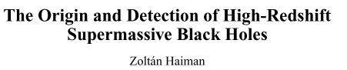
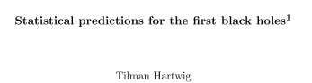
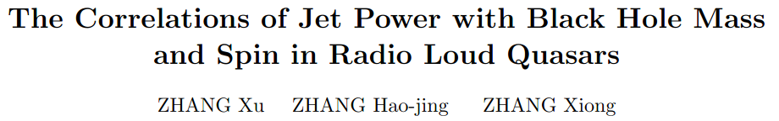
NO.4
SMBH
BH in high-redshift quasars is too young
but the mass is too large----
z=6, several billion solar mass
It grows very fast.
It challenges the theory of BH formation and growth

Slide 26
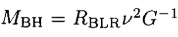
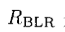
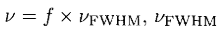
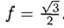
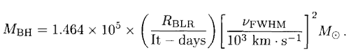
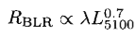
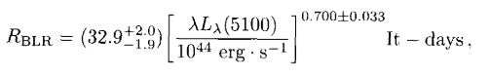
NO.4
SMBH
Mass of BH: Reverberation Mapping Method
Assuming that the gas in the wide-line region rotates around the black hole
is the radius of the wide line to the center of the black hole
is the width of the emission line, generally taking the width of Hβ
The virial mass of black holes is
Notes:
假设宽线区中的气体受黑洞引力场的影响绕黑洞旋转，则中心黑洞质量为 是宽线区到黑洞中心的半径。 是发射线的宽度，一般取Hβ发射线宽度， 。则黑洞的维里质量为 。
宽线区半径的经验公式 则得到 。

Slide 27
NO.4
SMBH
How does these SMBH grow？
Eddington's limited growth ?
the merger of the first generation of seeds BHs?
or by the rapid and direct collapse of gases
in rare special environments?
Notes:
通过中心超大质量黑洞的质量推测早期黑洞的形成与性质。现有的理论认为在黑暗时期结束后早期宇宙第一代 天体的形成大约是在大爆炸后3~4亿年, 如果早期黑 洞是第一代恒星(质量约100太阳质量)的塌缩而形成 的, 它由于快速吸积周围物质导致质量指数增长的 时标是约4千万年. 因此, 从第一代天体形成到存在120亿太阳质量的黑洞这期间只有5~6亿年.完全不足以增长到120亿太阳质量。

Slide 28
NO.4
SMBH
Conjecture of SMBH’s growth:
1. Super Eddington accretion in the process of black hole growth.
2. At the beginning of the formation of the black hole, the mass of its seed BH is much more heavier than that formed by the collapse of the first generation of stars, that is, a seed BH can be more than 100,000 solar masses.
3. the merger of black holes will accelerate the growth of black hole mass.
Notes:
通过中心超大质量黑洞的质量推测早期黑洞的形成与性质。现有的理论认为在黑暗时期结束后早期宇宙第一代 天体的形成大约是在大爆炸后3~4亿年, 如果早期黑 洞是第一代恒星(质量约100太阳质量)的塌缩而形成 的, 它由于快速吸积周围物质导致质量指数增长的 时标是约4千万年. 因此, 从第一代天体形成到存在120亿太阳质量的黑洞这期间只有5~6亿年.完全不足以增长到120亿太阳质量。

Slide 29
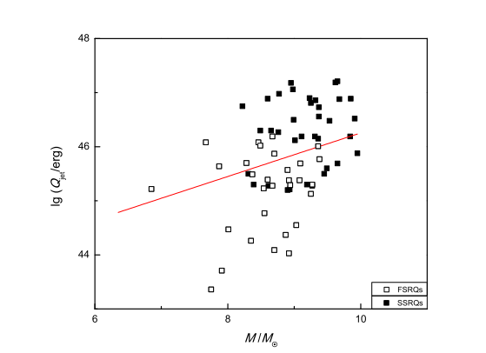
NO.4
SMBH
Correlation btw jet power and SMBH mass
Notes:
黑洞质量M与喷流能量Qjet具有较高的相关性, 说明黑洞质量与喷
流能量之间存在联系, 黑洞喷流的形成受到黑洞质量的影响, 黑洞质量越大形成的喷流 所携带的能量也就越多
黑洞产生喷流的机制及其具体结构目前仍然不清楚. 通常我们认 为喷流是在黑洞中心视界附近产生的, 此观点由Penrose在1969年首次提出, 他认为一个 自旋的黑洞存在着自旋能量[3]. Blandford等[4]认为这些能量能为黑洞的喷流供能.

Slide 30
NO.5
Summary and Future

Slide 31
NO.5
Summary and Future
Research hotspots of High-redshift quasars
①Searching and Confirmations---->completed samples
(Sky Survey from optical band to infrared, radio)
②Quasar classifications---->difference btw radio quasars
---->physical nature or AGN Unified Model ---->cosmic evolution
③SMBH in quasars ---->formation & growth ---->jet power & structure
Notes:
The unified model is due to the difference in direction of observation

Slide 32
NO.5
Summary and Future
Therefore, we need …
more observation and data
more frequency band
more high-resolution,
new instructions and methods
higher calculation speed!
Looking forward to SKA and our efforts !
Notes:
The unified model is due to the difference in direction of observation

Slide 33
REFERENCE
Fang G W, Lin Z S, Kong X. Morphology and Structure of High-redshift Massive Galaxies in the CANDELS Fields ☆, ☆[J]. Chinese Astronomy & Astrophysics, 2018, 42(1):20-29.
Xu W, Yu Y. Cosmological constant and high redshift galaxy observation.[J]. Acta Astronomica Sinica, 1996.
Zuo W W, Xue-Bing W U, Observatory S A. The search for high-redshift quasars[J]. Physics, 2016.
Fan X, Strauss M A, Richards G T, et al. A Survey of z>5.7 Quasars in the Sloan Digital Sky Survey IV: Discovery of Seven Additional Quasars[J]. Astronomical Journal, 2005, 125(4):1649-1659.
Willott C J, Delorme P, Omont A, et al. Four quasars above redshift 6 discovered by the Canada-France High-z Quasar Survey[J]. Astronomical Journal, 2007, 134(6):2435.
Lehnert M D, Nesvadba N P, Cuby J G, et al. Spectroscopic confirmation of a galaxy at redshift z = 8.6.[J]. Nature, 2010, 467(7318):940.
Mortlock D J, Warren S J, Venemans B P, et al. A luminous quasar at a redshift of z = 7.085.[J]. Nature, 2011, 474(7353):616-9.
Venemans B P, Findlay J R, Sutherland W J, et al. Discovery of three z > 6.5 quasars in the VISTA kilo-degree infrared galaxy (VIKING) survey[J]. Astrophysical Journal, 2013, 779(1).
Wang F, Wu X B, Fan X, et al. A survey of luminous high-redshift quasars with SDSS and WISE. I. target selection and optical spectroscopy[J]. Astrophysical Journal, 2016, 819(1):24.
Li Y. Accretion onto Intermediate-mass Seed Black Holes in Primordial Galaxies[J]. Physics, 2011.
Willott C J, Delorme P, Reyle C, et al. The Canada-France High-z Quasar Survey: nine new quasars and the luminosity function at redshift 6[J]. Astronomical Journal, 2010, 139(3):906-918.
Zhu X. High Redshift Quasars (Ⅰ): The Techniques of Detecting Quasars[J]. Progress in Astronomy, 1992.
Doi A, Nagai H, Asada K, et al. VLBI Observations of the Most Radio-Loud, Narrow-Line Quasar SDSS J094857.3 + 002225[J]. Publications- Astronomical Society of Japan, 2012, 58(5):829-834.
An T, Hong X Y, Wang W H, et al. VLBI Observations of the Blazar 1611+343 at 5 GHz[J]. Chinese Journal of Astronomy & Astrophysics, 2001, 1(4):305.
Kudryavtseva N A, Britzen S, Aller M F, et al. Activity cycles of blazars and quasars from the VLBI observations[C]// European Vlbi Network Symposium on the Role of Vlbi in the Golden Age for Radio Astronomy and Evn Users Meeting. 2008:8".
Cao H M, Frey S, Gurvits L I, et al. VLBI observations of the radio quasar J2228+0110 at z=5.95 and other field sources in multiple-phase-centre mode[J]. Astronomy & Astrophysics, 2014, 563(3):242-251.
Małgorzata A. Sobolewska, Siemiginowska A, Piotr T. Życki. High-Redshift Radio-quiet Quasars: Exploring the Parameter Space of Accretion Models. I. Hot Semispherical Flow[J]. Astrophysical Journal, 2004, 608(1):102-112.
Jiang L H, Xuebing W U, Wang R, et al. Observational studies on high-redshift quasars[J]. Chinese Science Bulletin, 2015, 60(25):2387.

Slide 34
THANK YOU FOR LISTENING

Slide 35
My work- VIBI data imaging
……see another report

